Slide 1
In the name of god
xamarin cross platform
siavash hasanpoor

Slide 2

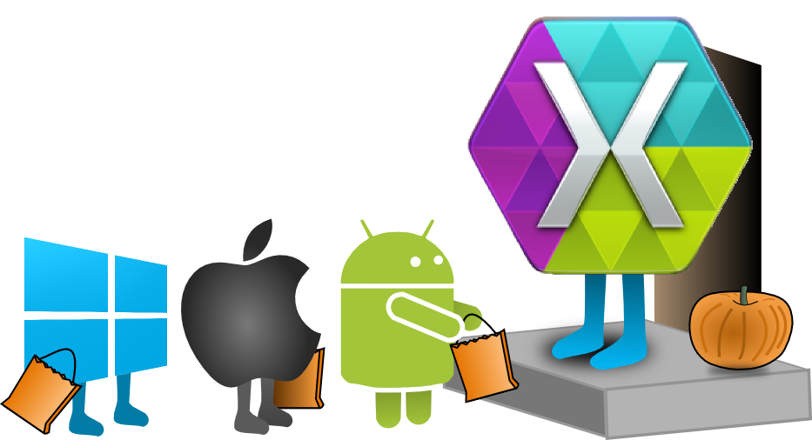
1/18

Slide 3
contents
What is the Xamarin ?
Three major part of xamarin
Three part of xamarin platform
Xamarin.Android
Xamarin.iOS
Xamarin.Forms
IDEs for xamarin
Which Xamarin approach is best for your app?
Xamarin Test Cloud
2/18

Slide 4
What is the Xamarin?
Xamarin is a Microsoft-owned software company founded in May 2011 by the engineers that created Mono.
Xamarin is cross-platform for mobile applications development
The C# code is compiled to native code for each OS
It works pretty fast
3/18

Slide 5
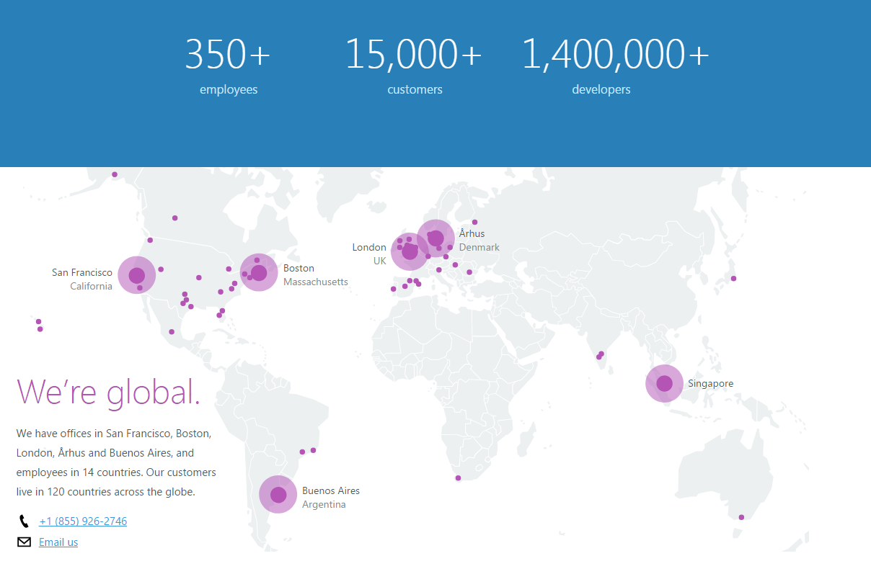

Slide 6
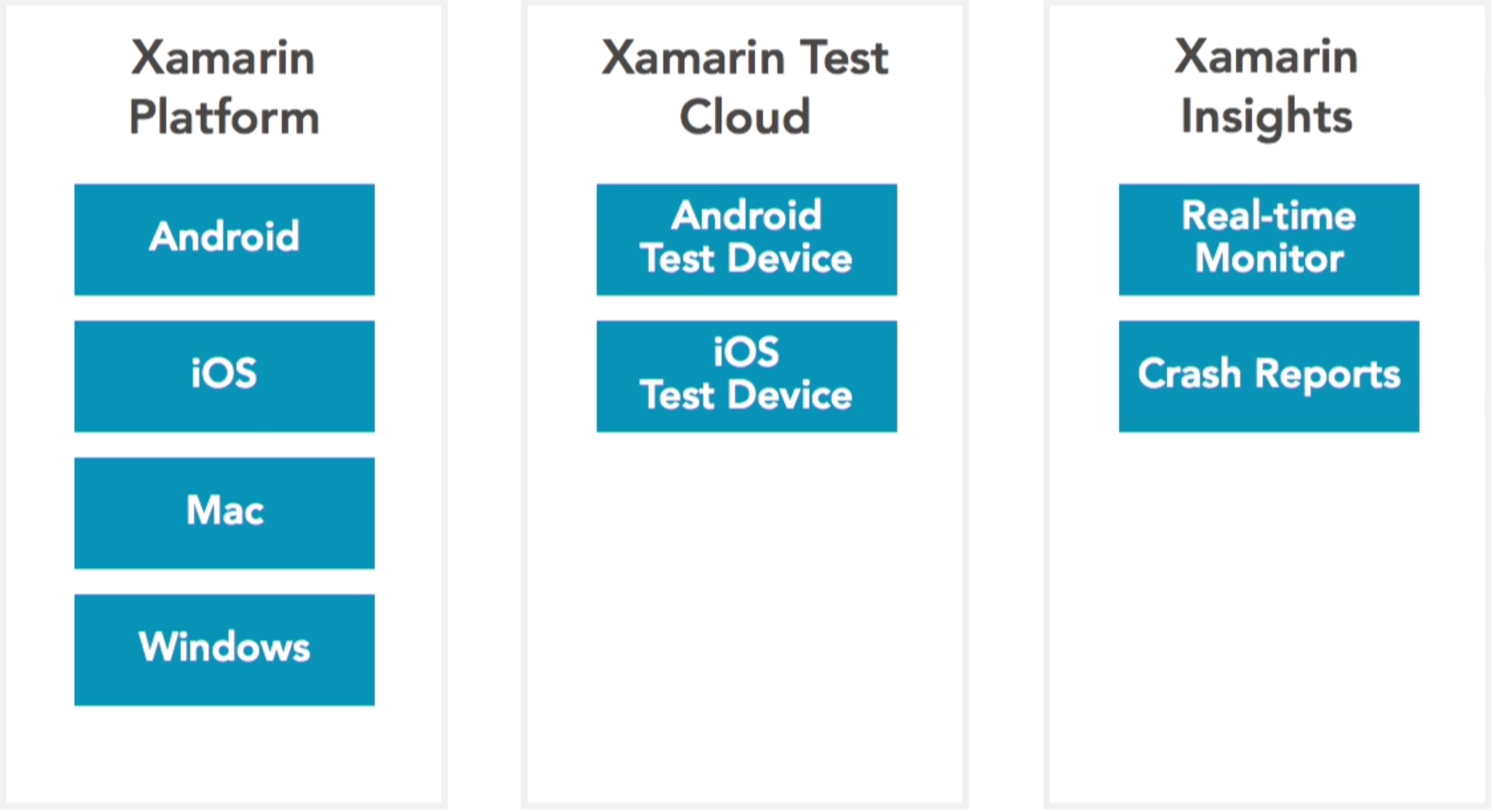
Three major part of xamarin
4/18

Slide 7
Three part of xamarin
Xamarin.Android
Xamarin.iOS
Xamarin.Forms

Slide 8
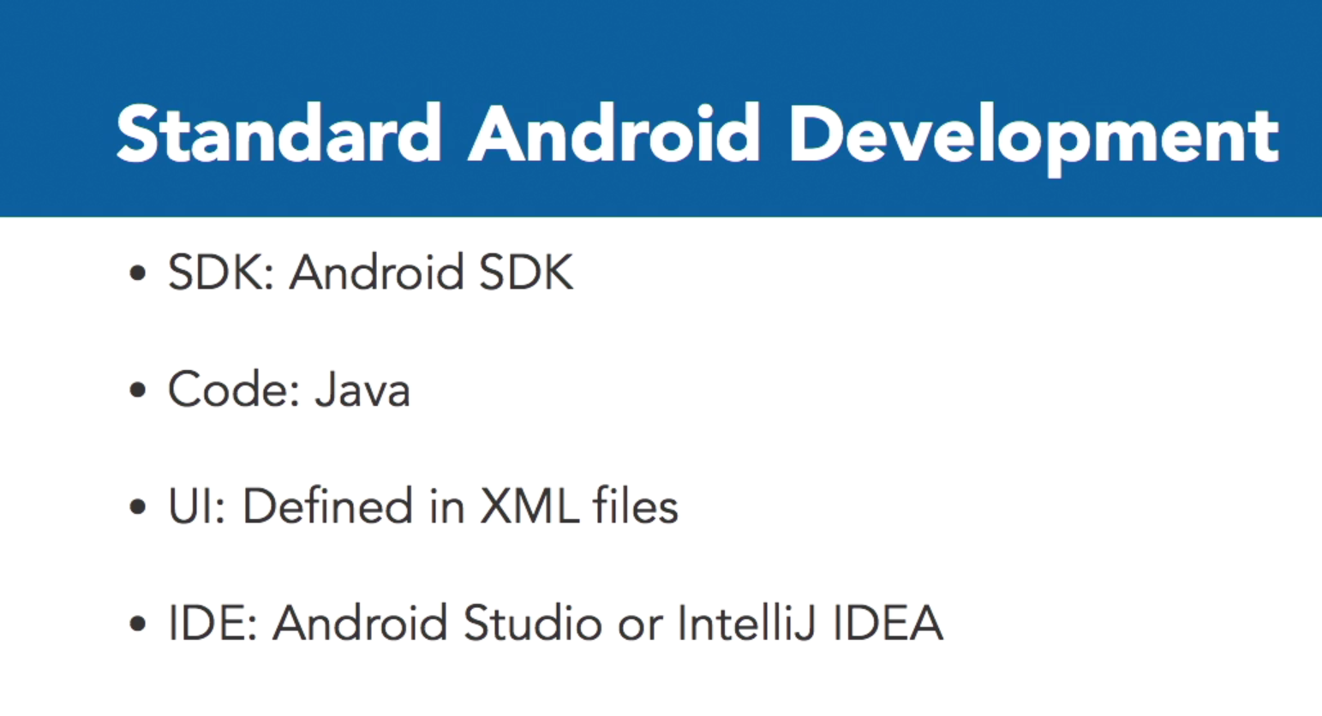
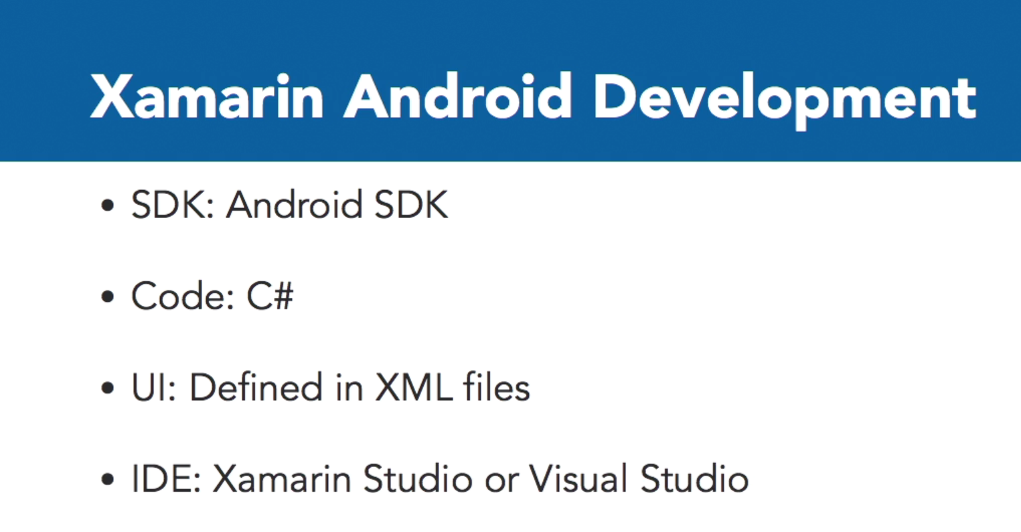
Xamarin.Android
5/18

Slide 9
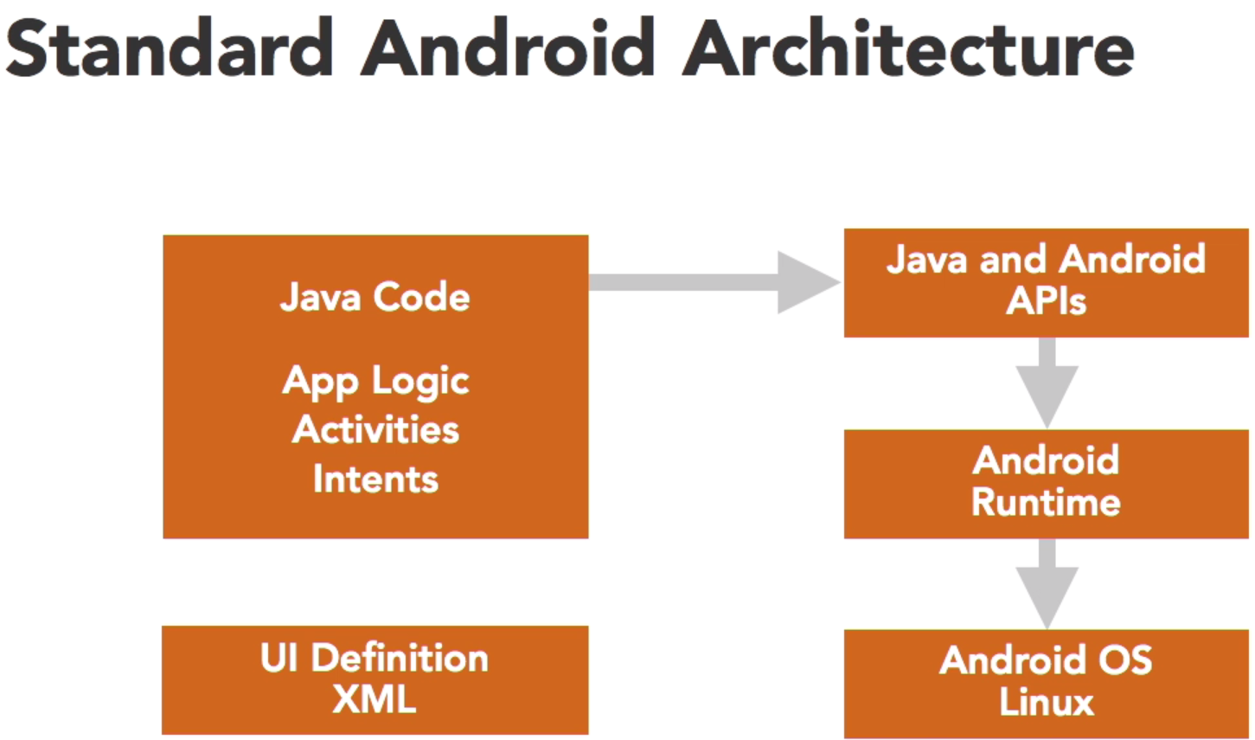
Xamarin.Android
6/18

Slide 10
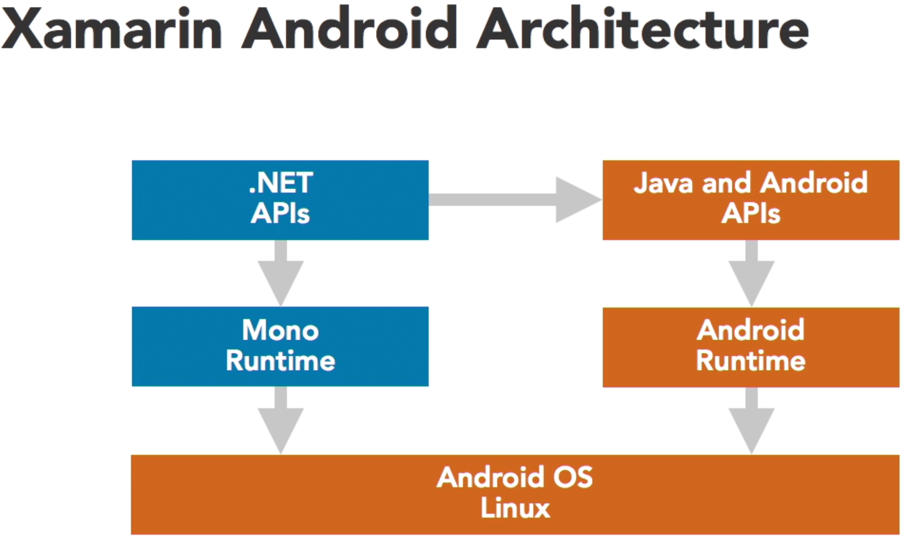
Xamarin.Android
7/18

Slide 11
Three part of xamarin
Xamarin.Android
Xamarin.iOS
Xamarin.Forms

Slide 12
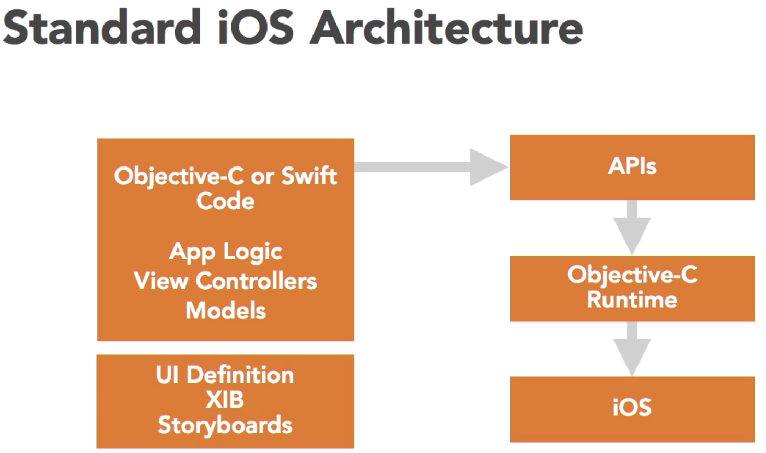
Xamarin.iOS
8/18

Slide 13
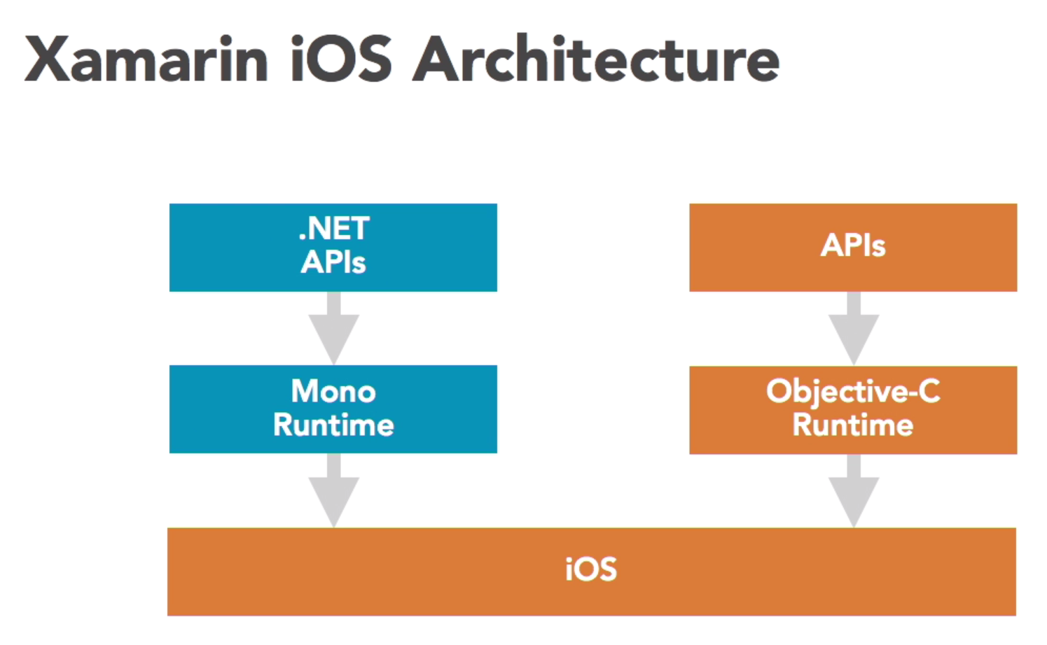
Xamarin.iOS
9/18

Slide 14
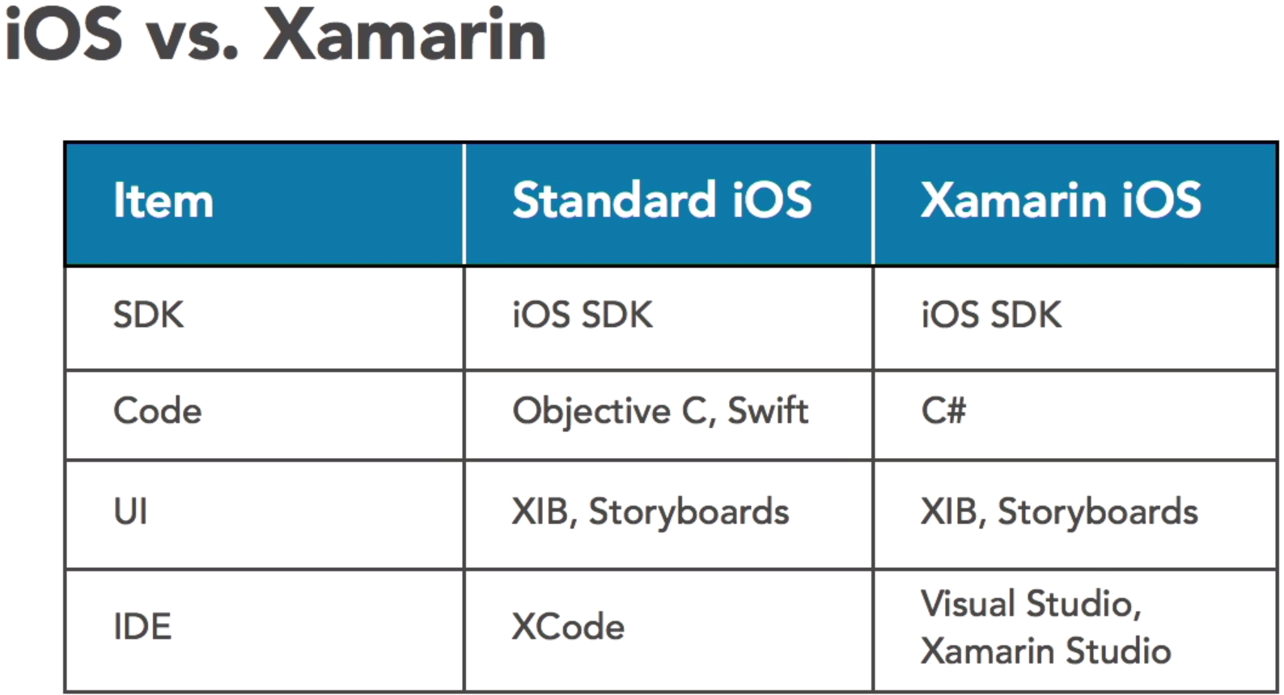
Xamarin.iOS
10/18

Slide 15
Three part of xamarin
Xamarin.Android
Xamarin.iOS
Xamarin.Forms

Slide 16
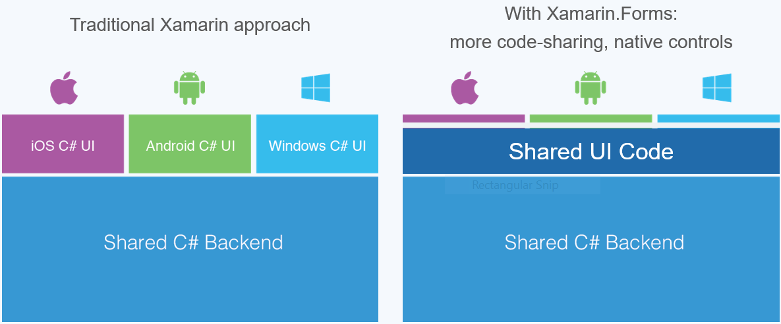
Xamarin.Form and difference with traditional xamarin approach
11/18

Slide 17
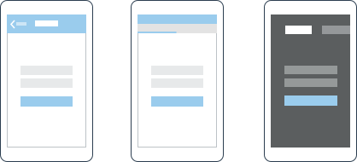
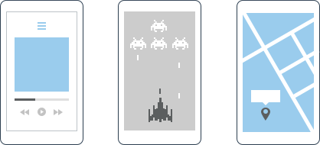
Which Xamarin approach is best for your app?
Xamarin.Forms is best for:
Apps that require little platform-specific functionality
Apps where code sharing is more important than custom UI
Developers comfortable with XAML
Xamarin.iOS & Xamarin.Android are best for:
Apps with interactions that require native behavior
Apps that use many platform-specific APIs
Apps where custom UI is more important than code sharing
12/18
Notes:
Xamarin.Form برای نرم افزار‌هایی بهتر است که:
به پلتفرم با کارایی‌ها کمتری نیاز داشته باشد.
Code sharing از Custom UI خیلی با مهمتر باشد.
Developer ها با XAML راحت تر باشد.
Xamarin.iOS و Xamarin.Formبرای نرم افزار‌هایی بهتر است که:
نیاز به تعامل‌هایی با رفتار های بومی (native behavior).
از API های زیادی استفاده می‌کند.
Custom UI ازCode sharing خیلی با مهمتر باشد.

Slide 18
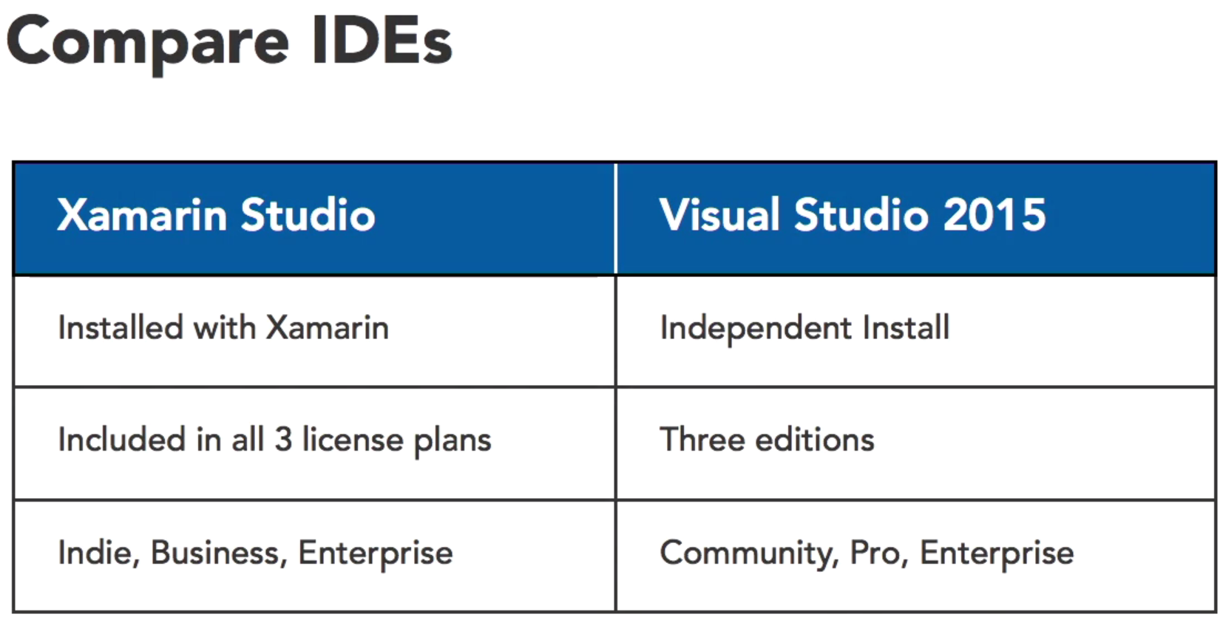
Xamarin Studio VS Visual Studio 2015
13/18

Slide 19
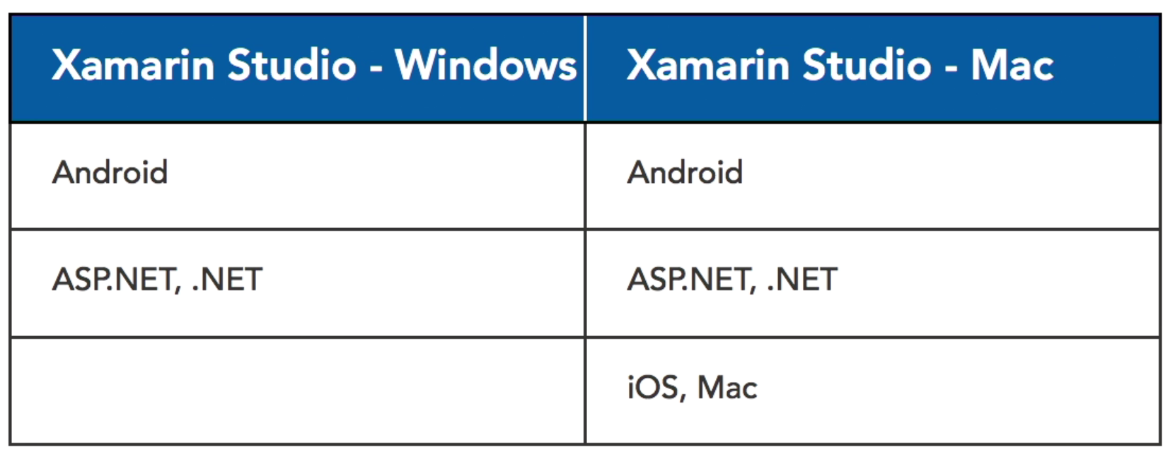
Xamarin Studio VS Visual Studio 2015
14/18

Slide 20
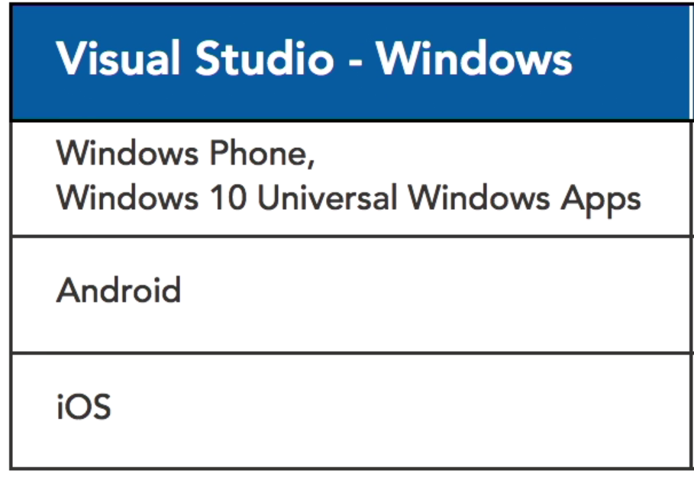
Xamarin Studio VS Visual Studio 2015
15/18

Slide 21

16/18

Slide 22
references
Lynda.com
wikipedia
17/18

Slide 23
Question?

Slide 24
THE END

